Slide 1
Blue Buffalo

Slide 2
Executive Summary and Methodology
The primary objective of the study is to determine if there is demand for Blue buffalo to expand their treat offerings.
Blue buffalo aims to increase their market share but introducing a new main line of treats.
As such, the objectives of this research are to :
Determine what qualities respondents look for in dog treats
Determine if our current treat offering have the qualities desired
Find out if there is a market for new treats
In order to address these objectives, we conducted an online survey asking both quantitative and qualitative questions
to our target demographic.
Target respondents met the following criteria:
Be between 18-34 years old.
Own a pet dog.
The online survey had 250 responses and was administered October 10-24 2024.

Slide 3
Executive Summary and Key Findings
Most of our respondents are female
16.8% of respondents had no top of mind brand and blue buffalo can pull some of these consumers.
Blue buffalo is in top three dog brands that our respondents were aware of. Milk Bone and Greenies are more well known than blue buffalo.
Health benefits are an important factor in 76% of consumers when choosing what pet food to buy.
Teeth Cleaning, Digestion assistance and Increased immunity are the top three health benefits consumers care about.
Treats are the most preferred product from future customers

Slide 4
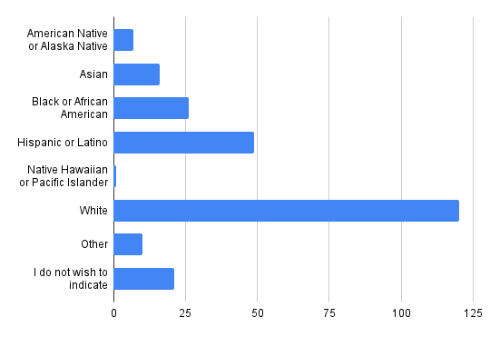
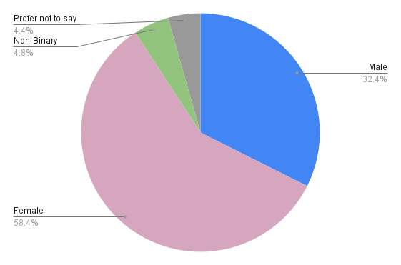
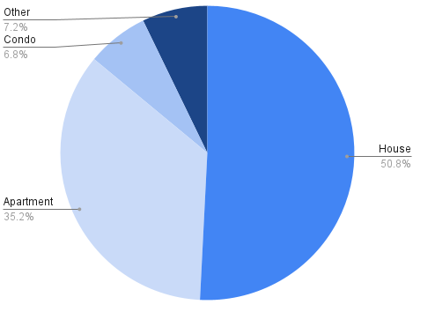
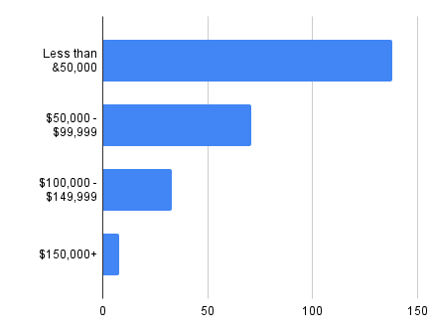
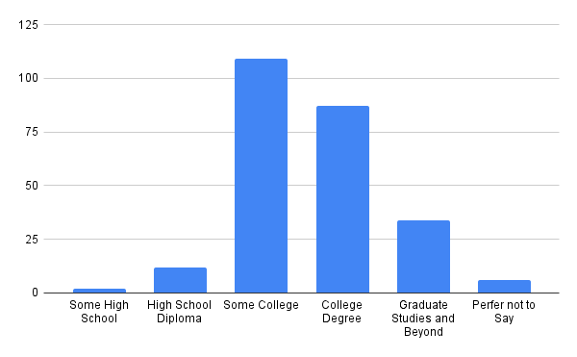
Respondent Profile

Slide 5
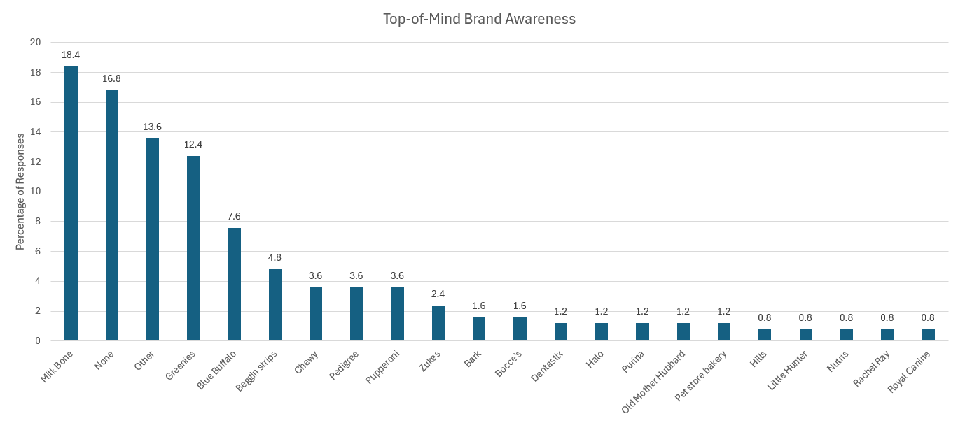
Top-of-Mind Awareness
The most common top of mind response was Milk Bone
Blue buffalo is in the top 5 top of mind dog treats
16.8% of respondents did not have a top of mind dog treat meaning there is room for growth
Base = Total Gen. Pop. (n=250)
Q7. When you think of dog treats, what is the first brand that comes to mind? If you cannot think of any, please type “none” in the space provided.

Slide 6
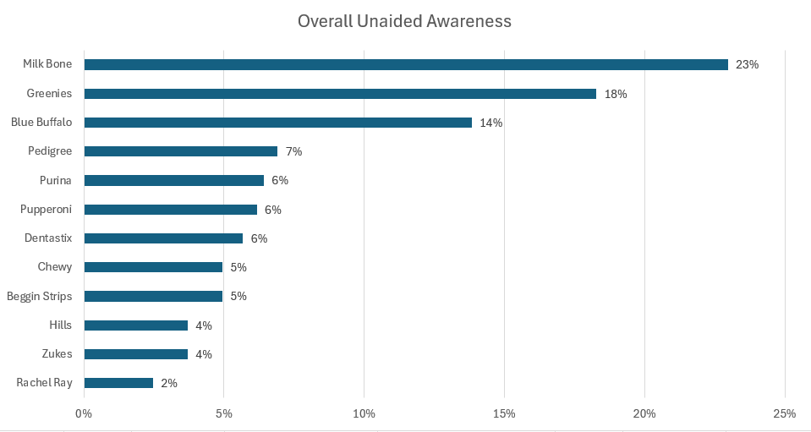
Unaided Awareness
The top unaided response was Milk Bone
Blue Buffalo ranked third in unaided mentions
The disparity in mentions after Blue Buffalo can allow for conversions from those low ranked categories
Base = Total Gen. Pop. (n=250)
Q8. And what other dog treat brands come to mind? If you can’t think of any, please type “none” below.

Slide 7
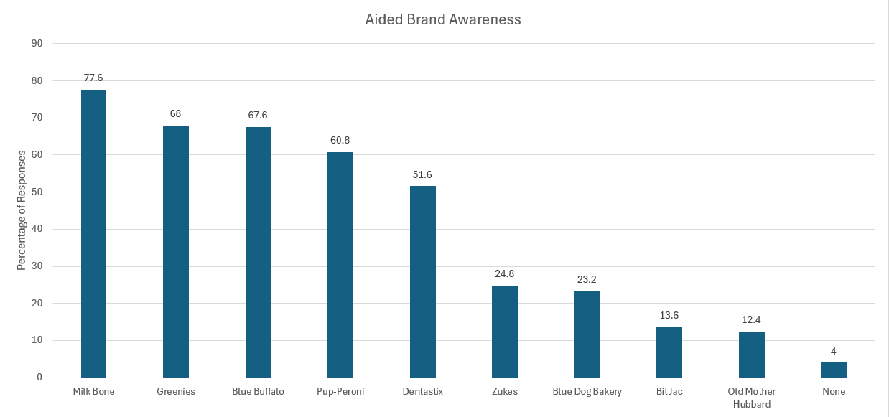
Aided Awareness
Milk Bone is the top category, solidifying them as a leading competitor
Blue Buffalo lands in third, being right behind Greenies
The gap between Blue Buffalo and Greenies is so low so it should be a priority to generate awareness and pass Greenies
Base = Total Gen. Pop. (n=250)
Q9. Which, if any, of the following dog treat brands have you heard of? Please be sure to select any dog treats that you have mentioned previously.

Slide 8
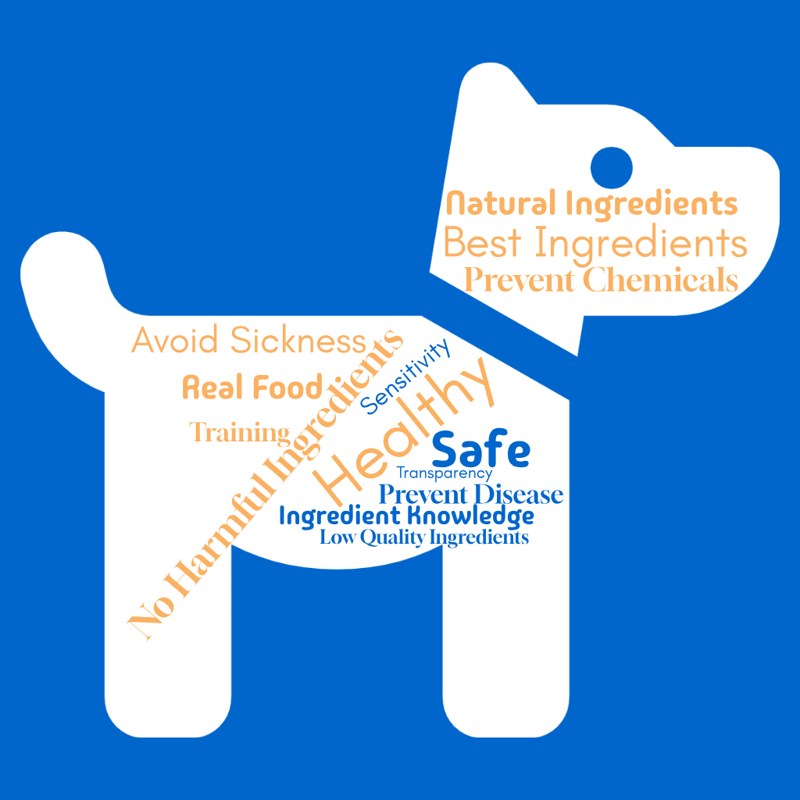
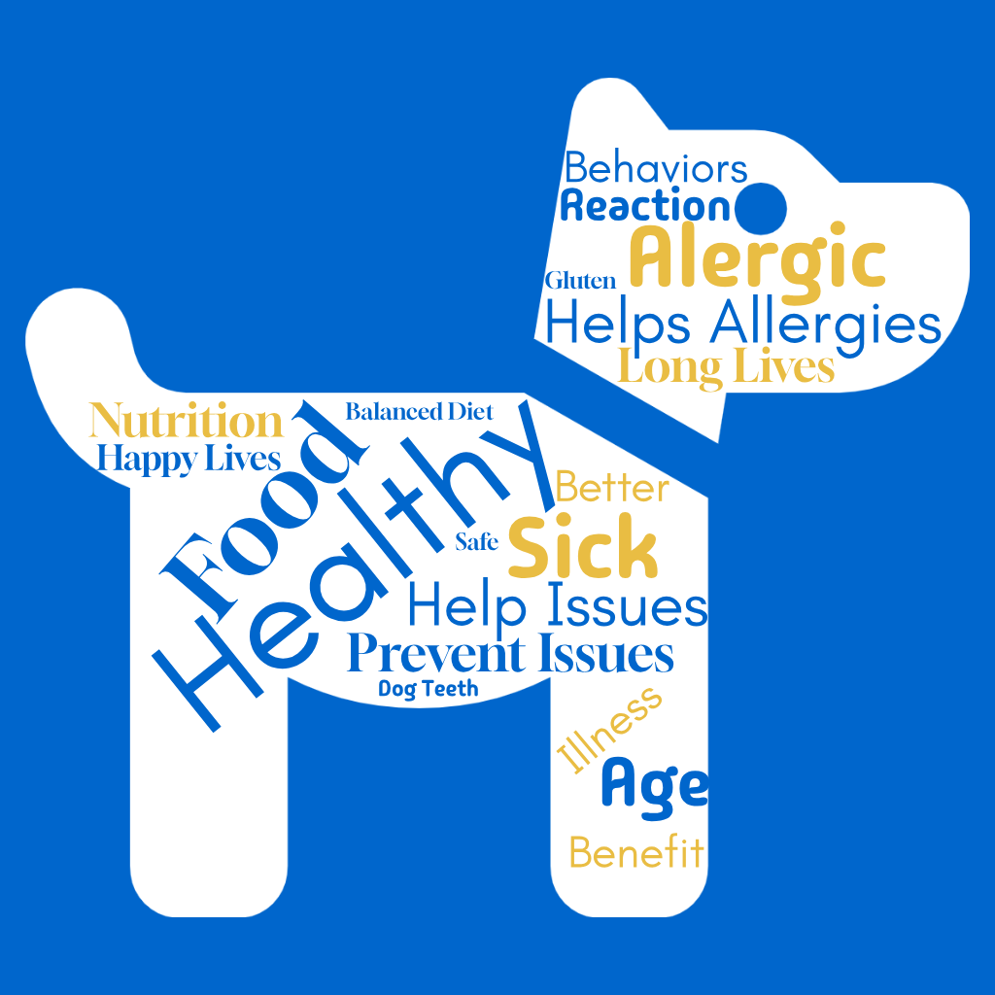
Importance Descriptors
Importance of Ingredients in treats
Importance of treats to target allergies & illnesses
Importance of treats to have extra vitamins & supplements
Base = Total Gen. Pop. (n=250)
Q10. Below are three (3) statements about dog treats. Please rank the statements below in order of importance to you with most important being ranked 1 and least important being ranked 3?
Q11. You selected [Pipe Answer From Q10] as the MOST important statement to you in the previous question, please tell us - why is it the most important

Slide 9
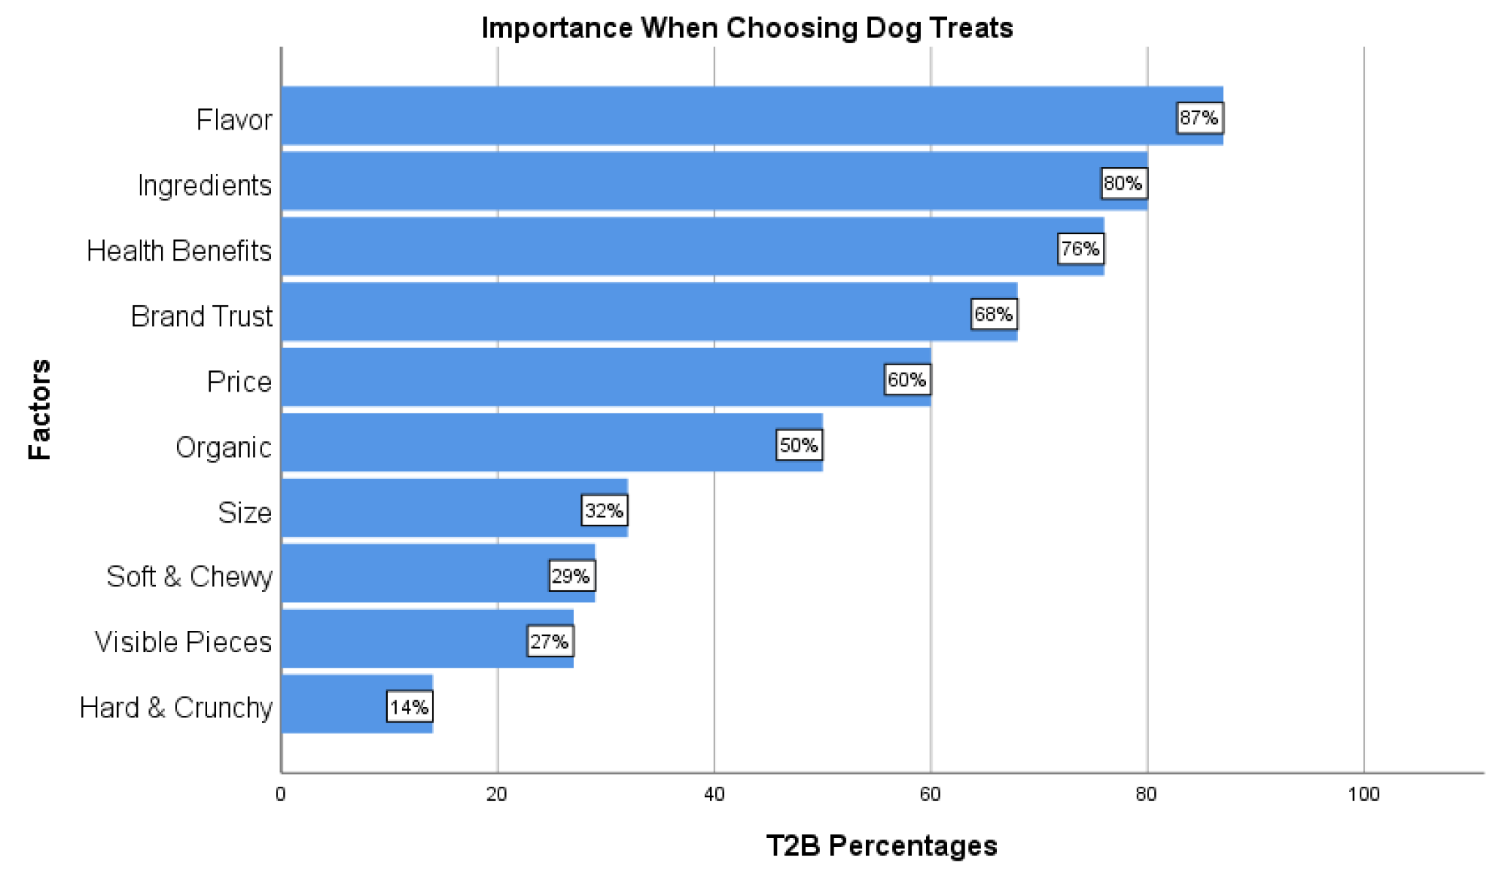
Importance When Choosing Dog Treats
Top 2 Box Summary
Dog treat purchasers value many things when choosing a treat option for their dogs.
However, the most important factors in dog treat selection are the flavor, ingredients, and health benefits.
Base = Total Gen. Pop. (n=250)
Q12. When purchasing dog treats, please indicate how important each of the following
factors are in your decision?

Slide 10
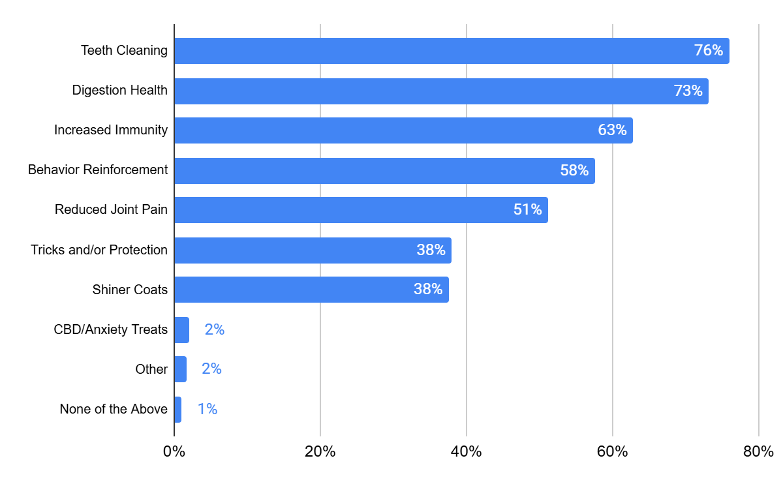
Health Benefits
Customers value teeth cleaning and digestion health the most out of any of the benefits
In the other section, CBD was suggested a couple times, leading to believe that some customers find it important
Base = Total Gen. Pop. (n=250)
Q13. Which health benefits are important to you when deciding upon giving treats to your
dog(s)?

Slide 11
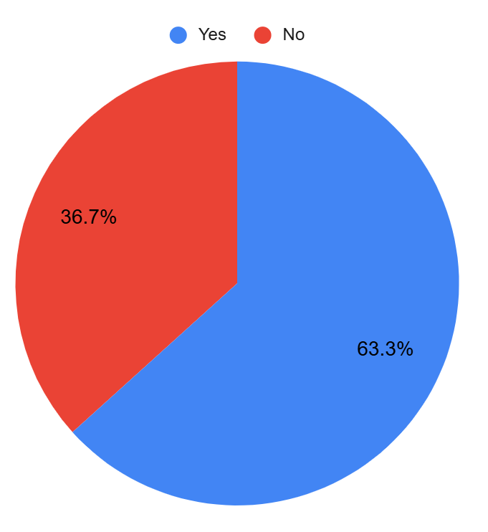
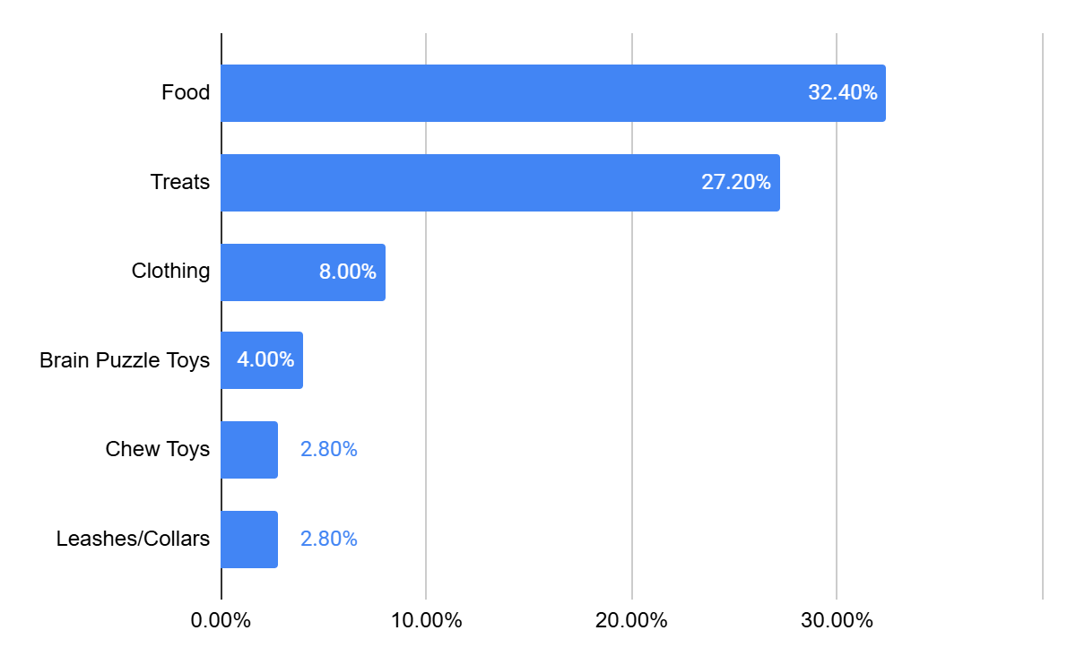
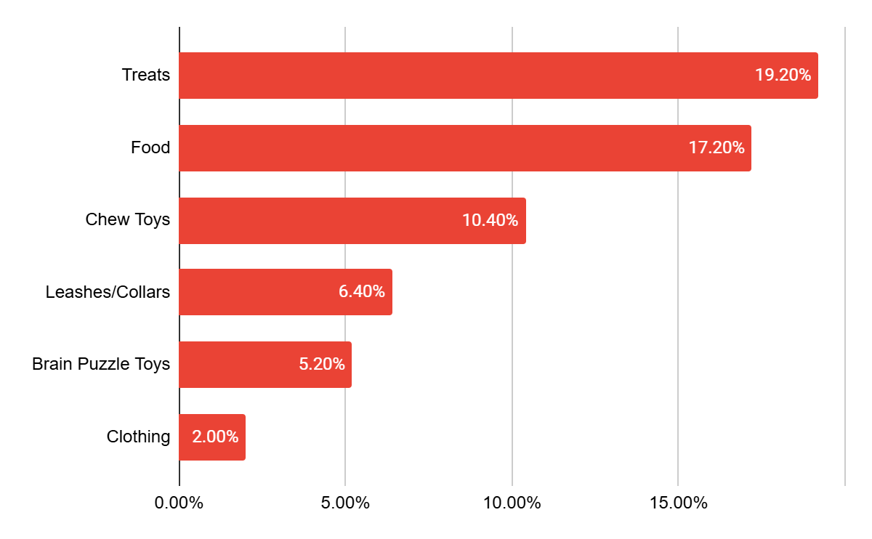
Product Preference
For both customers and non-customers, food and treats are what they look for in Blue Buffalo
For non-customers, things like chew toys and other accessories are also interesting to them
Have Purchased
Might Purchase
Base = Total Gen. Pop. (n=250)
Q14 .,You've indicated that you have heard of the Blue Buffalo Brand. Have you ever purchased products from this brand? Q15 Which of the following products have you purchased from Blue Buffalo?, Q17 You have indicated that you have not purchased products from the Blue Buffalo brand. Would you consider purchasing any of the following products if they were improved/added to the brand?

Slide 12
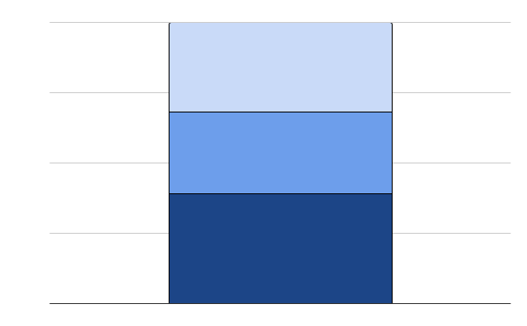
Net Promoter Score
Net Promoter Score is a good way to deduce brand health.
Net Promoter Score =
31.8% - 39.2% =
- 7.4%
Promotors (9-10)
31.8%
Neutral (7-8)
29%
Detrators (0-6)
39.2%
Base = Total Gen. Pop. (n=250)
16. How likely are you to recommend Blue Buffalo to someone looking to purchase dog products?

Slide 13
Recommendation
We believe that Blue Buffalo should produce a new treat line.
There is a lot of potential new customers and current customers that want treats from Blue Buffalo
This new treat line should focus health aspects like teeth cleaning and digestion support. They should keep their flavor and ingredients in mind.
This new treat line will keep our current customers coming back while prioritizing new consumers and trying to bring in some new loyal customers.

