Slide 1
Nespresso
Camryn Fives
Alyssa Neri
Gus Emery
Logan Brinkworth
Katie Riordan

Slide 2
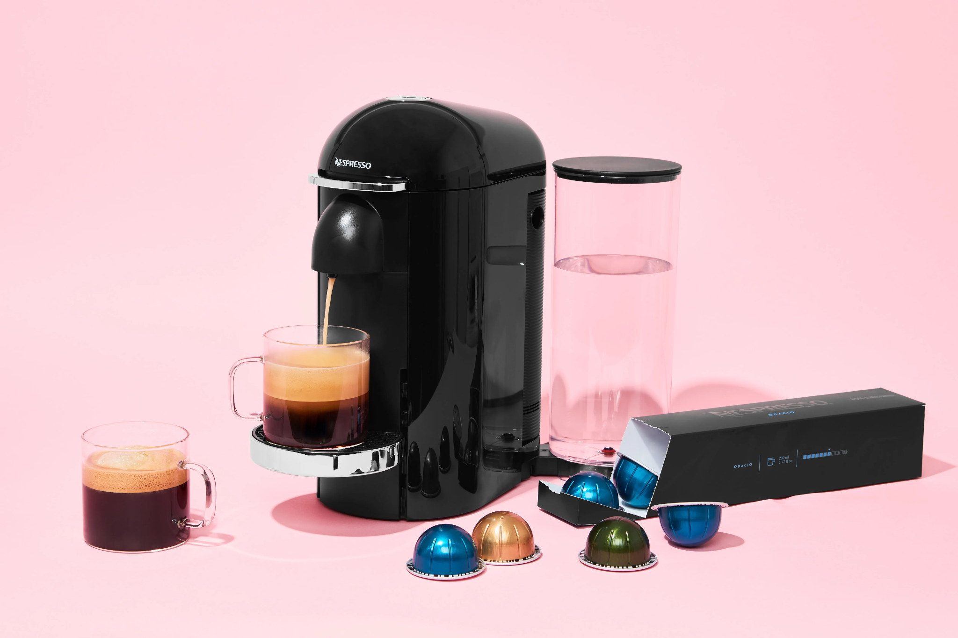
Why Nespresso?
Nespresso is an international brand
Present in 81 countries; bringing luxury coffee and espresso machines straight from the cafe to your home.
Nespresso utilizes retro-modern espresso machines and a wide selection of coffee pods.
Notes:
Why Nespresso? Nespresso is an international brand, present in 81 countries bringing luxury coffee and espresso machines straight from the cafe to your home. Nespresso utilizes retro-modern espresso machines and a wide selection of coffee pods.

Slide 3
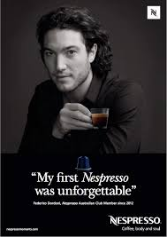
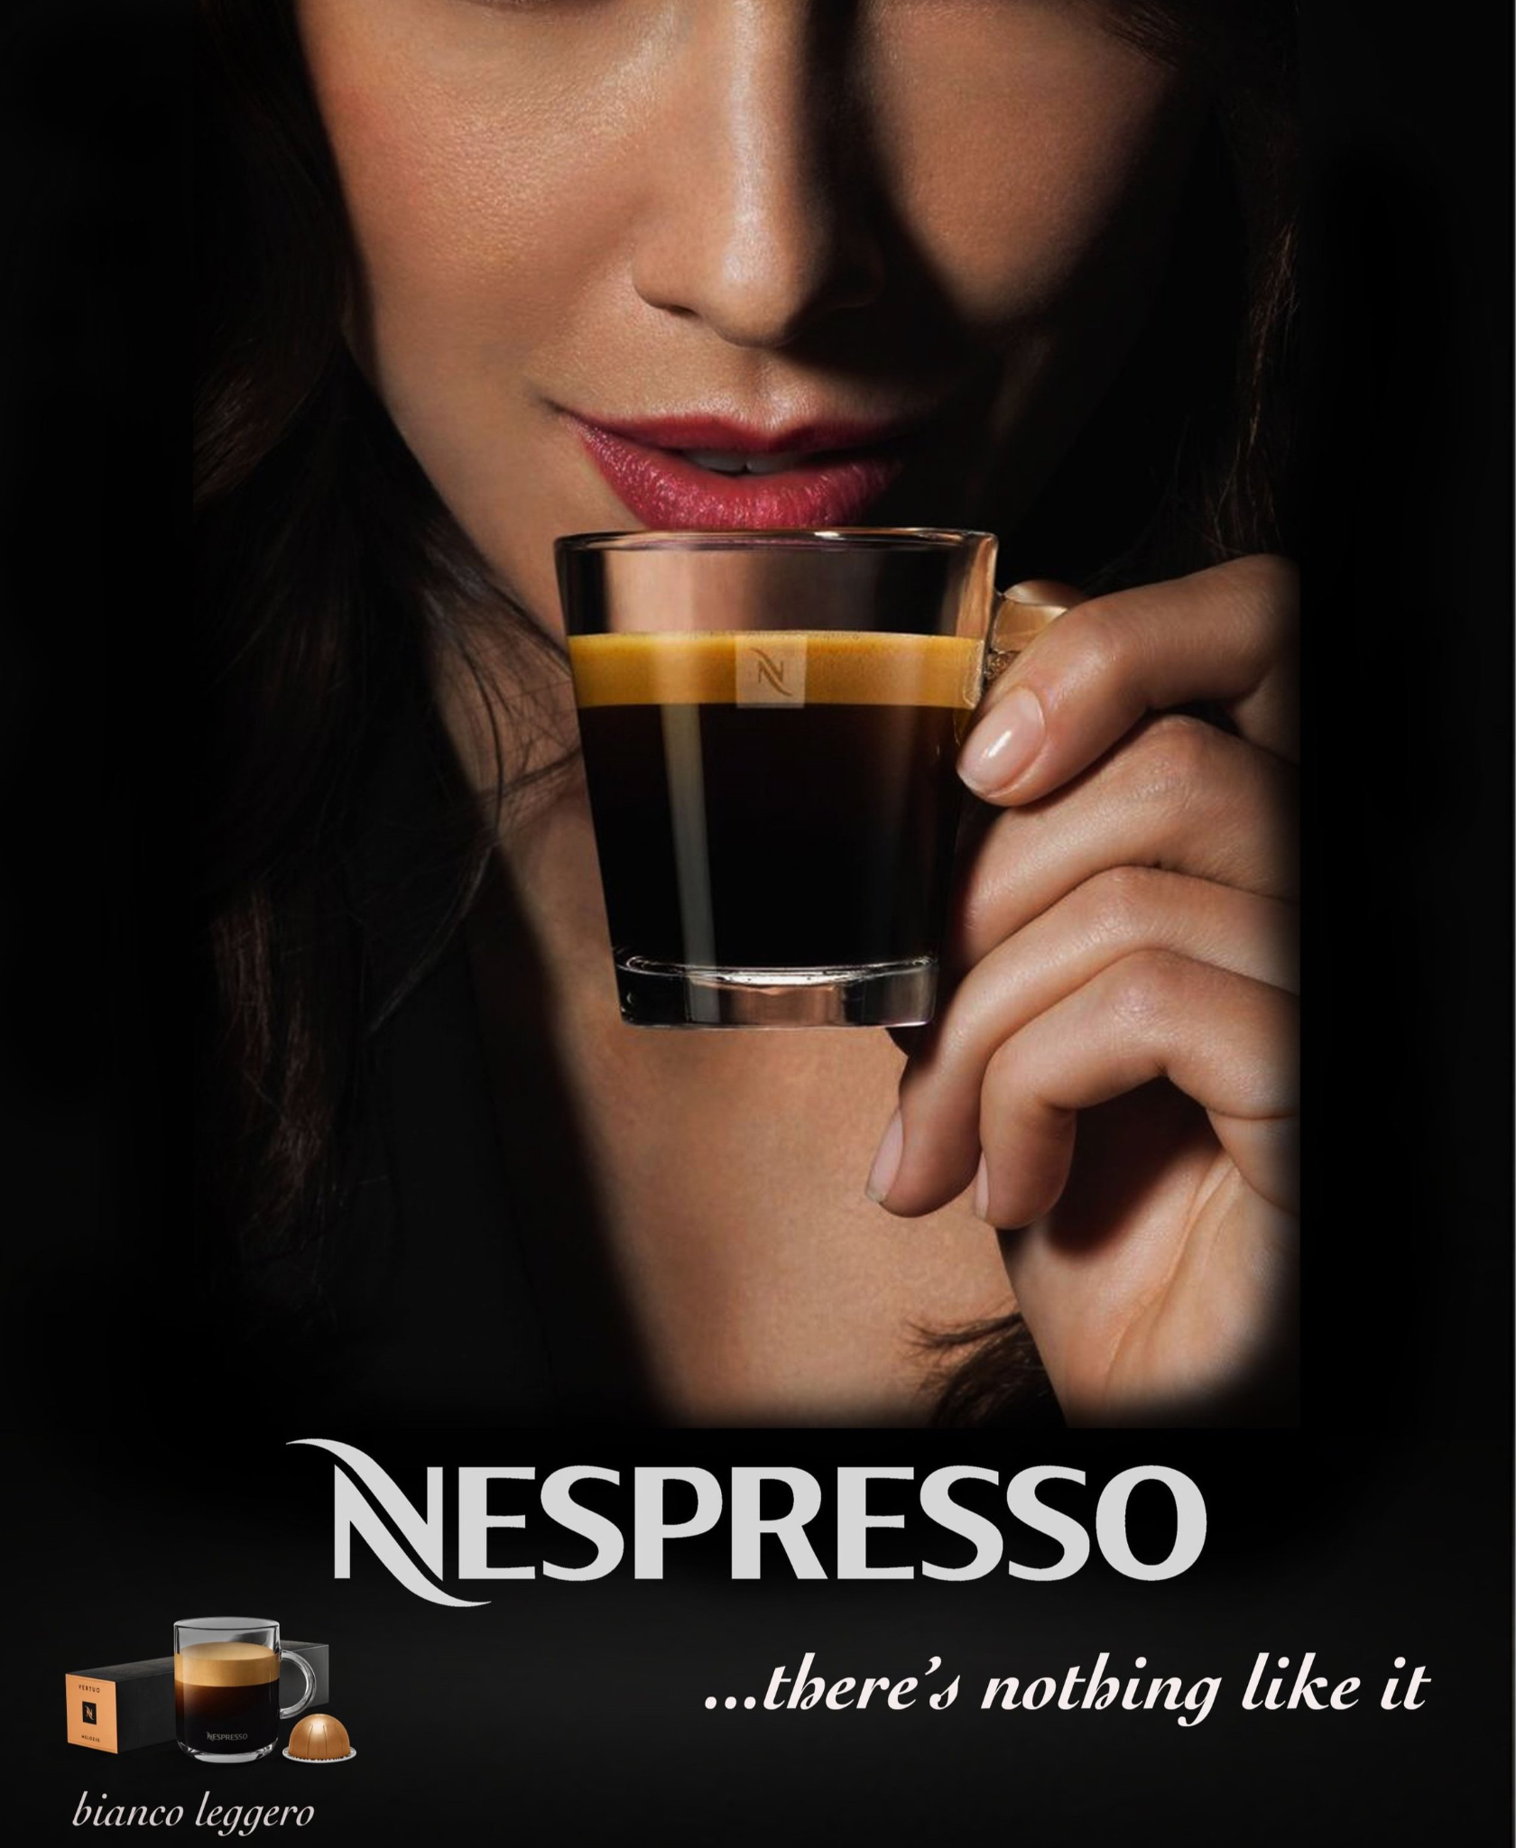
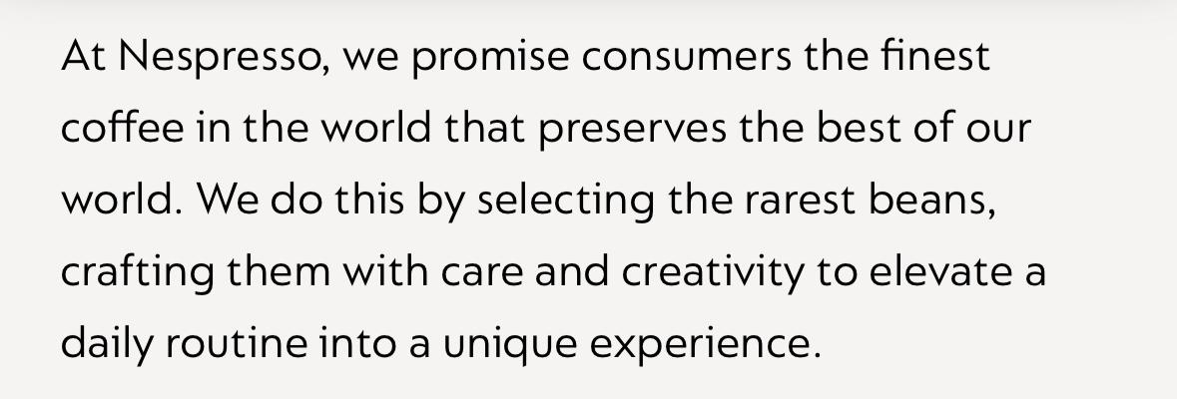
Market Segmentation
Individuals value
Luxury
Quality
Convenience
Lifestyles
Active, social and creative lifestyle
Enjoys travel, luxury dining, modern living, social gatherings
Motivations & Attitudes - Driven by:
Sophistication, Modernity, Environmental Consciousness
Esteem and Self-actualization needs
Notes:
Nespresso targets Upper-middle to upper-class young adults who could be early in marriage, first-time homeowners, or single living in apartments. Their target audience value luxury, quality, and convenience in life and in a coffee experience too. They are active, social, and creative individuals who enjoy traveling, luxury dining, and social gatherings. Their customers prefer their coffee machines to match their homes: sleek and classy, and are driven by sophistication, modernity, and tend to lean towards environmentally friendly and sustainable products.
Nespresso satisfies esteem and self-actualization needs by aligning with upscale, eco-conscious lifestyles. They connect with consumers desired self-perceptions and the luxury shown within ads make those of similar class want what they have. Nespresso utilizes partnerships with premium hotels, airlines, luxury brands, and the use of celebrities to showcase a modern aspirational lifestyle, and to portray a "sexy" luxurious feel.
I think the best way to describe their audience is consumers who fit into the upper class persona and especially those who strive to fit in without having the wealth to actually be the upper class.

Slide 4
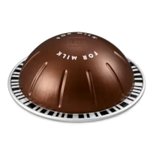
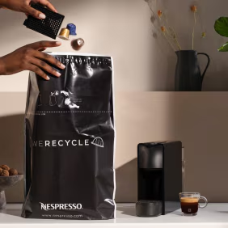
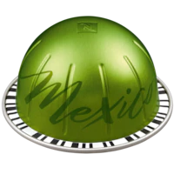
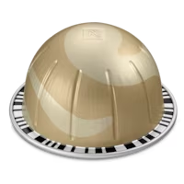
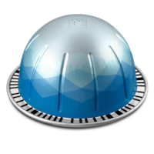
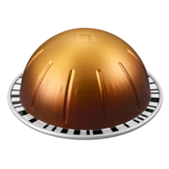
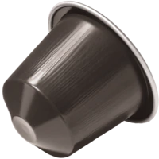
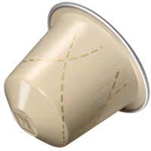
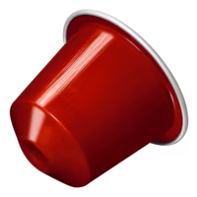
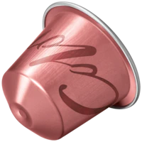
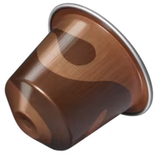
Product Positioning
Internal Influences
Positioned in affluent markets
“Luxury” market
Sustainability efforts
Decision Process Influences
Key factors: quality, durability, usability, price
Variety of flavored pods
Pod description listed online
Higher luxury machines offered
Different pod types available
Notes:
Internal Influences:
Nespresso positions their brand in affluent and more liberal markets, with a focus on active and environmentally conscious people.
Also marketed towards people with higher disposable income
Placed in the “luxury” market for providing a premium coffee experience at home
Nespresso gives high quality coffee at a higher price for original investment and is positioned towards customers looking for a convenient, high quality coffee experience.
Also focused on sustainability efforts and encourages customers to recycle used coffee pods and emphasizes that their coffee is sustainably sourced
Decision process Influences
Key factors include quality of coffee, sleek machine and durability, ease of use, and price per cup of coffee.
Nespresso provides a variety of flavors of pods to appeal to various customers, including coffee enthusiasts
Nespresso’s website/app includes tasting notes, level of intensity or body, and roast level for each coffee pod.
Higher prices machines are made available to customers looking for even more of a luxury experience
Different types of pods are for different machines (Original Nespresso pods vs Vertuo Nespresso pods)

Slide 5
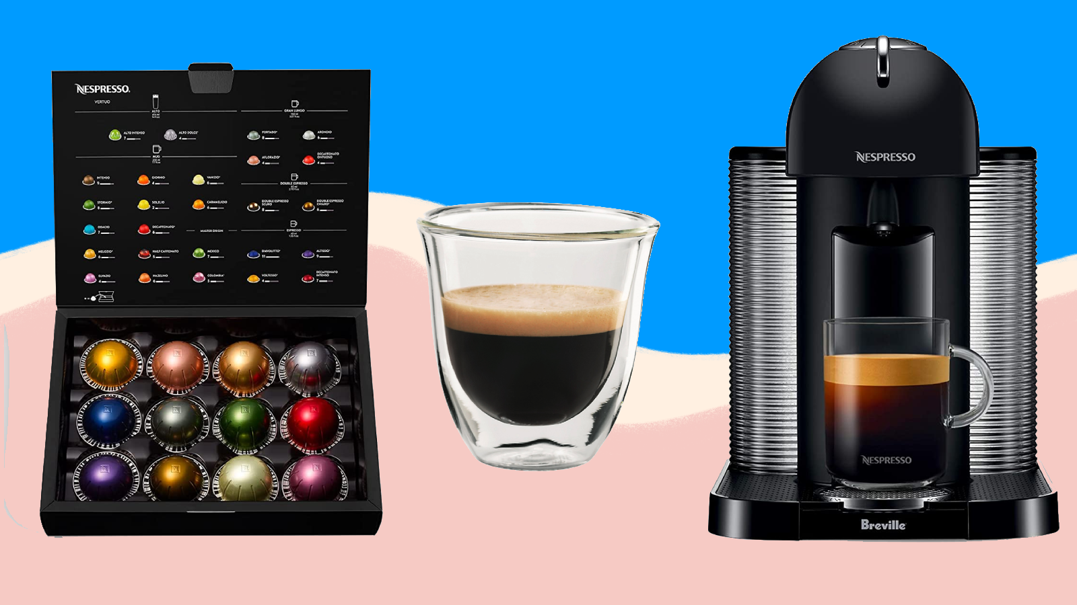
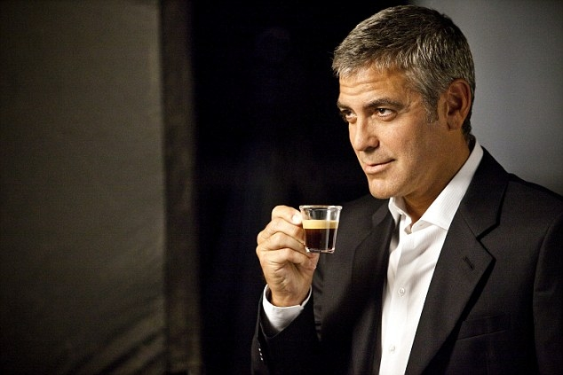
Pricing
Market Price:
Ranges from $100 to $700 depending on the machine.
Cognitive Bias
Since nespresso divides its prices into different components, consumers feel like they are spending less.
Internal & External Influences
Price is an indicator of status
“luxury” purchase
Exclusive product due to price

Slide 6
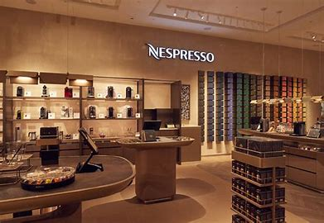
Distribution Strategy
Nespresso’s distribution strategy emphasizes:
The customer experience
Exclusivity
Premium branding
Sustainability
Carefully combines its own retail operations with third-party retail partnerships
Nespresso offers various channels including:
E-Commerce
Brick and Mortar boutiques
Selective third-party distribution
Makes sure to distribute to a customer in every step of the journey to becoming a lifetime consumer
Notes:
Nespresso has modeled their distribution strategy to target a customer in every step of the process of becoming a lifetime user.
Internal Influences
Nespresso offers a luxurious brand experience using boutiques and in store displays to entice coffee lovers and while also making it accessible to new customers
External Influences
Nespresso uses a high-service channel that includes a knowledgeable staff to provide support to customers to ensure the full Nespresso experience.
CJM Journey
Dreaming
Watching a commercial
Walking into a boutique
Research
Looking at the website
Going to the store and looking at the options
Buying
Making the decision of just buying coffee, the pods, or a coffee maker even
Experiencing
Making the coffee and hopefully loving it
Visiting the website and writing a review
Post-Purchase
Joining the Nespersso Rewards
Visiting boutiques

Slide 7
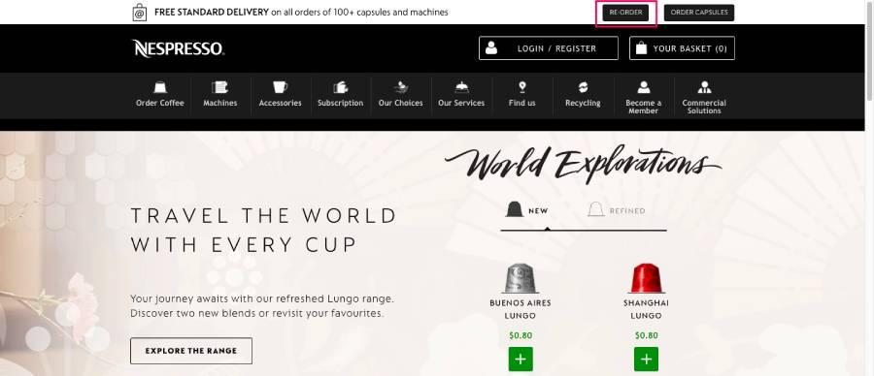
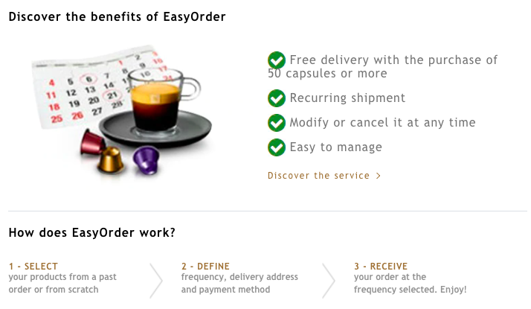
Promotion Strategy
Feel-Think-Do Model
Affective response
Sensory appeal
“Pleasure of a morning brew”
“Perfectly crafted at home espresso”
Atmospherics
Self-concept
Travelers, fashion-centric individuals, etc.
Positive reinforcement
“Nespresso Club”
Notes:
Feel - Going into a boutique and smelling the coffee, watching the commercials and experiencing the luxury
Think - Looking at the prices and deciding if its something for you, considering the other options
Do - Buying the product, big or small or even just taking a sample, experiencing Nespresso for yourself
Atmospherics- Sense of smell and the aroma of freshly roasted coffee
Nespresso represents a sense of upper class while still being affordable to the majority, something for everyone

Slide 8
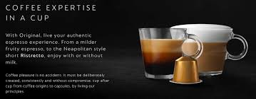
Promotion Strategy
Marketing Budget and Resources
Support Long-term brand strategy
Sales Channels and Distribution Networks
Strongest Influences
Retail, Online, Distribution
Notes:
Internal Factors
Marketing Budget and Resources: The type and scope of campaigns that Nespresso will be able to run will be determinant on the allocation of financial resources within the company. Historically, Nespresso has relied on high-profile celebrity endorsements to promote a luxurious brand image, as well as global campaigning. Both of these factors will undoubtedly require an in-depth resource allocation strategy. Sales Channels and Distribution Networks:
Promotional methods are influenced by the ease in which consumers can access their products.This factor can effectively be addressed through online sales promotions, in-store experiences, or limited-edition offers.
The strongest influences will include the impact of retail stores, online presence, and partnerships with distributors.

Slide 9
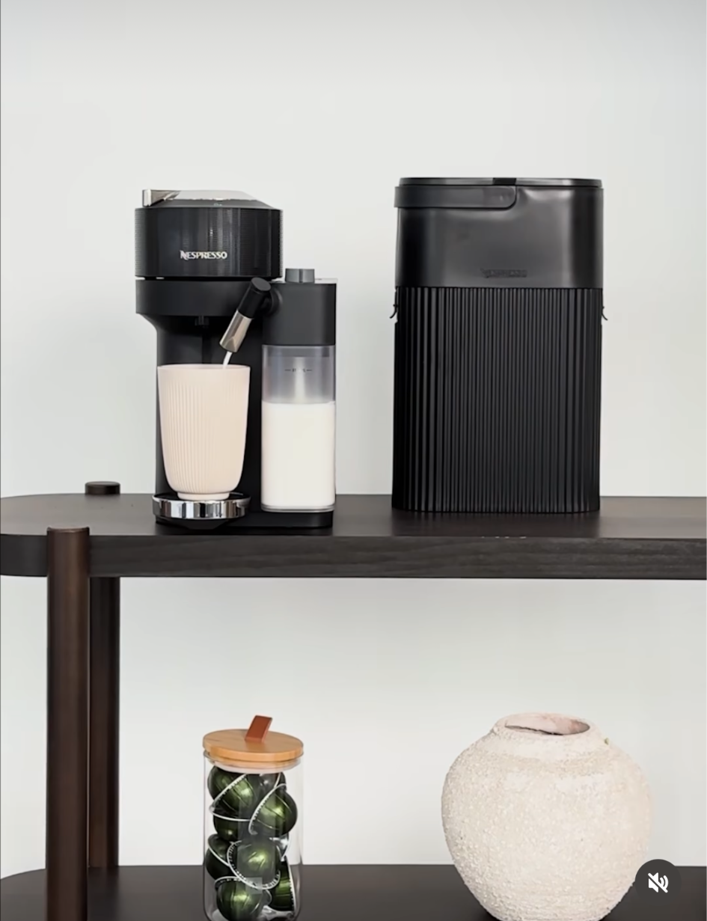
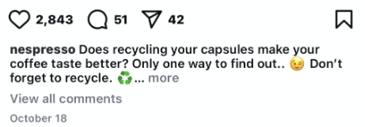
Product
Unique Features:
Elegant design
Easy use
Premium coffee experience
Wide variety of pod flavors (seasonal promotions/holiday specials)
Standard, Premium, Deluxe, REVOLVE
Eco-Friendly
Notes:
Nespresso machines come in various sizes and colors, and they tend to stick to neutral colors. All machines maintain sleek, simple, and classy designs with disposable containers for used pods to minimize compost and add-ins are offered for an additional price such as their build-in milk frothers. Their product is an easy to use machine that provides a premium at home coffee experience. Additionally, they offer lots of variety from a wide range of pod flavors to a range of machines that vary in finish and color, represented in their Standard, Premium, Deluxe, and REVOLVE machines.
Finally, Nespresso upholds their commitment to sustainability through green initiatives such as recyclable materials and pod recycling programs, Tree planting efforts to offset carbon and Aluminum recycling and advocacy. Their social media ads highly target environmentalists.

Slide 10
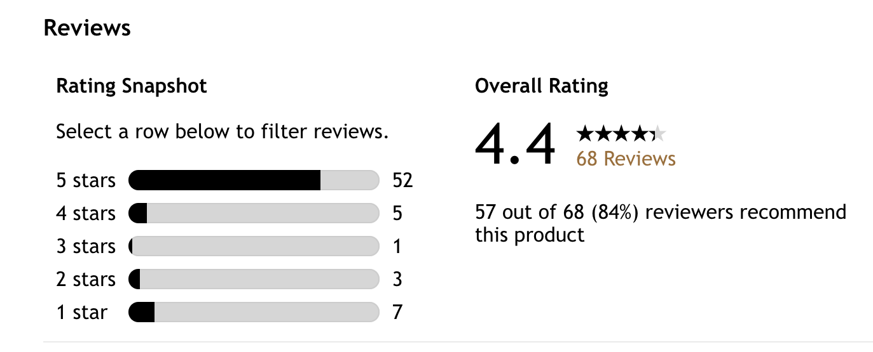
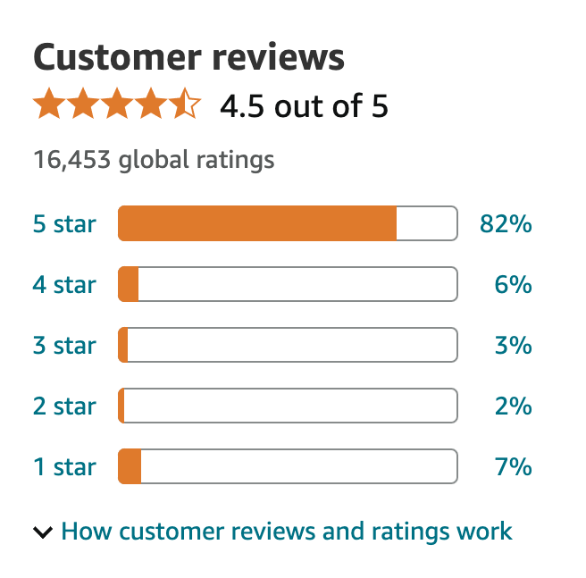
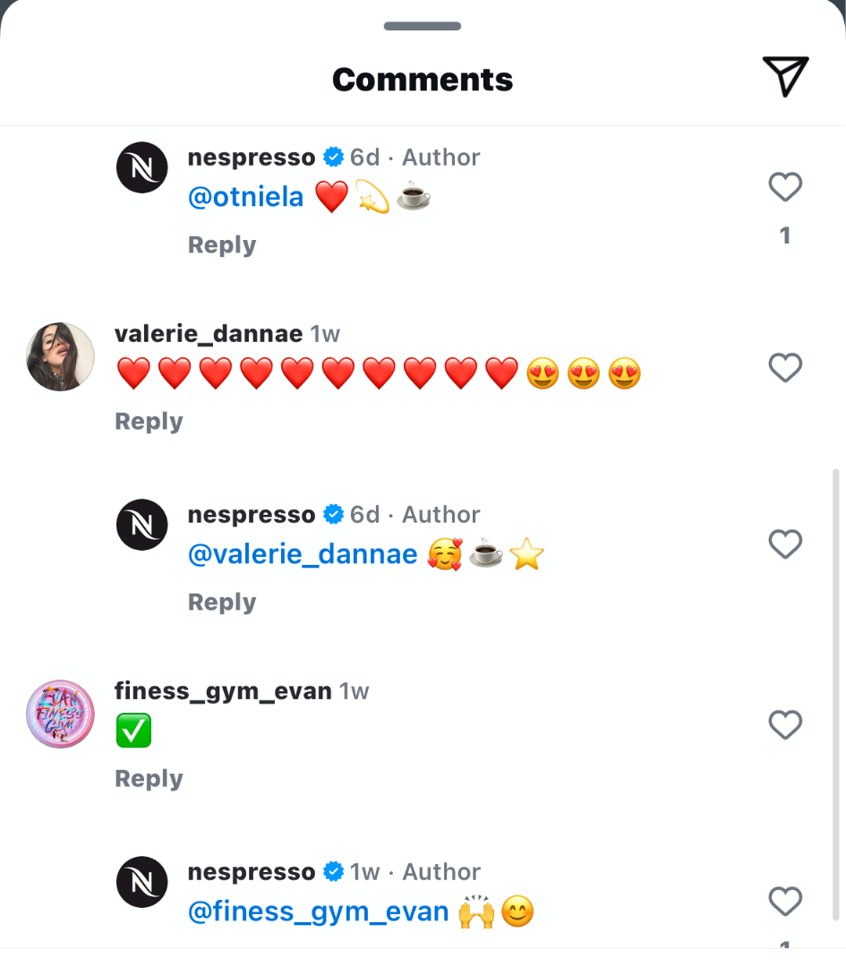
Customer Satisfaction
Most Satisfied
Quality
Experience
Most Unsatisfied
Shipping/Delivery
Cost
Satisfaction varies by machine/pod type
Around 4.5 Star rating on avg.
Replies to every comment on Instagram!
Notes:
Nespresso consumers are Most Satisfied with :
Instrumental performance: Quality & Experience
Most Unsatisfied:
Shipping/Delivery
Cost of pods and machines
Poor reviews could be tied to cognitive dissonance as some consumers make impulse decisions and rationalize expensive products but cannot afford the future investment of the product. The negative reviews are often replied to by the company to try and fix the complaints
Nespresso gets a small amount of comments on their posts on Instagram, but they reply to every comment! This establishes strong customer relations to the brand.
Nespresso earned 4.5 starts from over a thousand plus reviews on Target and the same score from over 16,000 reviews on Amazon. Website has additional reviews around the same 4.5 star mark

Slide 11
The End.
Thank you!

Slide 12
Site Sources
https://cupcaketeam75.wordpress.com/2019/05/19/positioning-statement-of-the-nespresso-boutique-flon/
https://www.nespresso.com/ncp/positive/de/en#!/sustainability/innovations https://www.webprofits.com.au/blog/nespresso
Additional information gathered from Nespresso website, social media (Instagram), and reviews on Amazon.
`

